Slide 1
Notes:
Chapter 8 Scheduling Resources and Costs

Slide 2
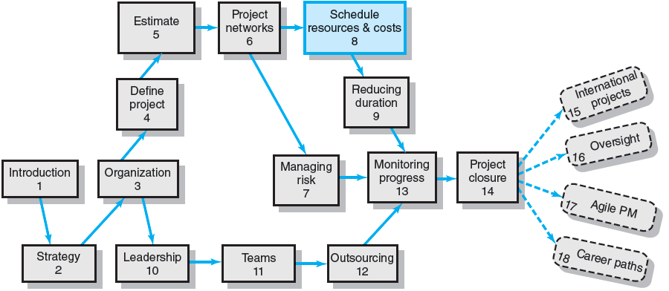
Where We Are Now
Notes:
In Chapter Eight, we learn that project managers must pay attention to the usage and availability of resources to avoid resource bottlenecks and the associated costs of crashing project activities when developing a project schedule. Project managers must understand that the results of resource scheduling can be significantly different from the results of the standard CPM method. The project resource schedule provides a reliable baseline both measuring time differences between plan and actual and for developing a time-phased project cost budget baseline.

Slide 3
Overview of the Resource Scheduling Problem
Resources and Priorities
Project network times are not a schedule until resources have been assigned.
The implicit assumption is that resources will be available in the required amounts when needed.
Adding new projects requires making realistic judgments of resource availability and project durations.
Cost estimates are not a budget until they have been time-phased.
Notes:
Project network times are not a schedule until available and adequate resources have been assigned. Given the implicit assumption of scarcity of organizational resources, adding new projects requires making realistic judgments about present resource availability and current project durations. Project cost estimates are not a budget until they have been time-phased to create the project’s resource cost baseline.

Slide 4
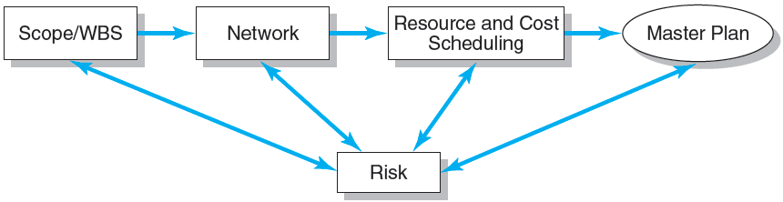
Project Planning Process
FIGURE 8.1
Notes:
Figure 8.1 depicts the constant need for managers to consider the effects of risks at each stage of the of the project planning process.

Slide 5
The Resource Problem (cont’d)
Resource Smoothing (or Leveling)
Involves attempting to even out varying demands on resources by using slack (delaying noncritical activities) to manage resource utilization when resources are adequate over the life of the project.
Resource-Constrained Scheduling
The duration of a project may be increased by delaying the late start of some of its activities if resources are not adequate to meet peak demands.
Notes:
Project managers use resource smoothing (or leveling) to even out varying demands on resources by using slack (delaying noncritical activities) to manage resource utilization when adequate resources are available over the life of the project.
Resource-constrained scheduling is used by project managers to increase the duration of a project by delaying the late start of some of its activities if available resources are not adequate to meet peak demands.

Slide 6
Types of Project Constraints
Technical or Logic Constraints
Constraints related to the networked sequence in which project activities must occur.
Physical Constraints
Activities that cannot occur in parallel or are affected by contractual or environmental conditions.
Resource Constraints
The absence, shortage, or unique interrelationship and interaction characteristics of resources that require a particular sequencing of project activities
Kinds of Resource Constraints
People, materials, equipment
Notes:
Project constraints related to people, materials, equipment resources typically fall into three categories:
Technical or logic constraints related to the networked sequence in which project activities must occur.
Physical constraints caused by activities that cannot occur in parallel or are affected by contractual or environmental conditions.
Resource constraints due to the absence, shortage, or unique interrelationship and the interaction characteristics of resources that require a particular sequencing of project activities

Slide 7
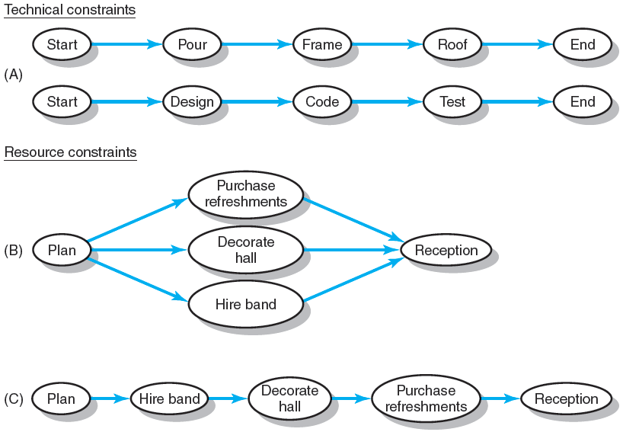
Constraint Examples
FIGURE 8.2
Notes:
Figure 8.2 depicts the technical, resource and dependency sequencing constraints associated with three different projects. Interrelationships and interactions among time and resource constraints can be complex for even small project networks. Project managers must be careful to schedule resources to ensure availability in the right quantities and at the right time.

Slide 8
Classification of a Scheduling Problem
Classification of Problem
Using a priority matrix will help determine if the project is time or resource constrained.
Time-Constrained Project
Must be completed by an imposed date.
Time is fixed, resources are flexible: additional resources are required to ensure project meets schedule.
Resource-Constrained Project
Is one in which the level of resources available cannot be exceeded.
Resources are fixed, time is flexible: inadequate resources will delay the project.
Notes:
Project managers can use a priority matrix to determine if the project is time or resource constrained.
For a time-constrained project, completion is required by an imposed date. When time is fixed, available resources must be flexible enough to ensure project meets schedule.
For a resource-constrained project in which a fixed level of available resources cannot be exceeded, anticipating delays in the time to project completion is required due to the inadequacy or unavailability of resources that will likely delay the project.

Slide 9
Resource Allocation Methods
Limiting Assumptions
Splitting activities is not allowed—once an activity is start, it is carried to completion.
Level of resources used for an activity cannot be changed.
Risk Assumptions
Activities with the most slack pose the least risk.
Reduction of flexibility does not increase risk.
The nature of an activity (easy, complex) doesn’t increase risk.
Notes:
Assumptions about constraints on resources and estimates of risk associated with activities impose limits on how project managers deal with the splitting activities and changing the level of resources once projects have begun.

Slide 10
Resource Allocation Methods (cont’d)
Time-Constrained Projects
Must be completed by an imposed date.
Require use of leveling techniques that focus on balancing or smoothing resource demands.
Use positive slack (delaying noncritical activities) to manage resource utilization over the duration of the project.
Peak resource demands are reduced.
Resources over the life of the project are reduced.
Fluctuation in resource demand is minimized.
Notes:
Scheduling time-constrained projects focuses on optimizing resource utilization by using leveling techniques that use the delay inherent in the positive slack of noncritical activities to reduce peak resource demands such that additional resources are available to critical activities.

Slide 11
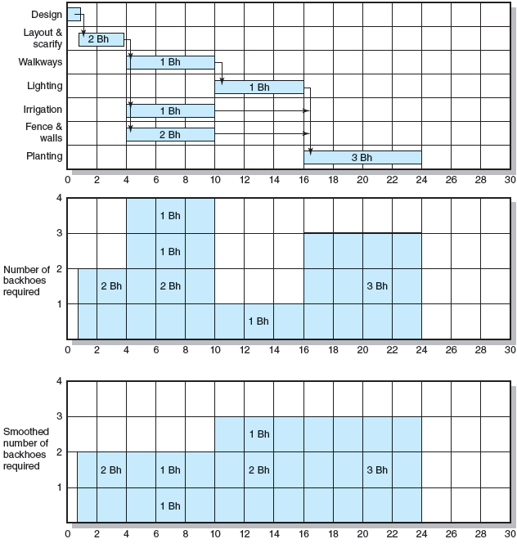
Botanical Garden
FIGURE 8.3
Notes:
Figure 8.3 provides an example of linear charting of leveling technique procedures for a time-constrained project that optimizes the monthly utilization of backhoe equipment by the staff of a botanical garden over a thirty-day time period.

Slide 12
Resource Allocation Methods (cont’d)
Resource Demand Leveling Techniques for Time-Constrained Projects
Advantages
Peak resource demands are reduced.
Resources over the life of the project are reduced.
Fluctuation in resource demand is minimized.
Disadvantages
Loss of flexibility that occurs from reducing slack.
Increases in the criticality of all activities.
Notes:
Resource demand leveling techniques for time-constrained projects have the advantages of reducing peak demands, resources over the life of the project are reduced and fluctuation in resource demand is minimized. Disadvantages of leveling are loss of flexibility that occurs from reducing slack and increased criticality of all activities as their dependencies increase.

Slide 13
Resource Allocation Methods (cont’d)
Resource-Constrained Projects
Resources are limited in quantity or availability.
Activities are scheduled using heuristics (rules-of-thumb) that focus on:
Minimum slack
Smallest (least) duration
Lowest activity identification number
The parallel method is used to apply heuristics
An iterative process starting at the first time period of the project and scheduling period-by-period the start of any activities using the three priority rules.
Notes:
Resource-constrained projects have resources that are limited in quantity or availability. Activities are scheduled using the parallel method of applying heuristics (rules-of-thumb) with the goals of achieving minimum slack, smallest (least) duration, and the lowest activity identification number in an iterative process starting at the first time period of the project and scheduling period-by-period the start of any activities using the three priority rules.

Slide 14
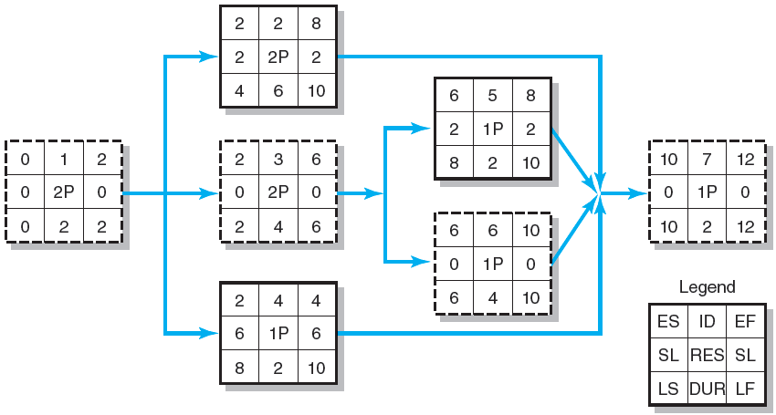
Resource-Constrained Schedule through Period 2–3
FIGURE 8.4
Notes:
Figures 8.4 begins as series of boxed figures that demonstrates the scenario of scheduling (using late start and early finish times) limited resources in real projects and the resulting increase in the risk of being late.

Slide 15
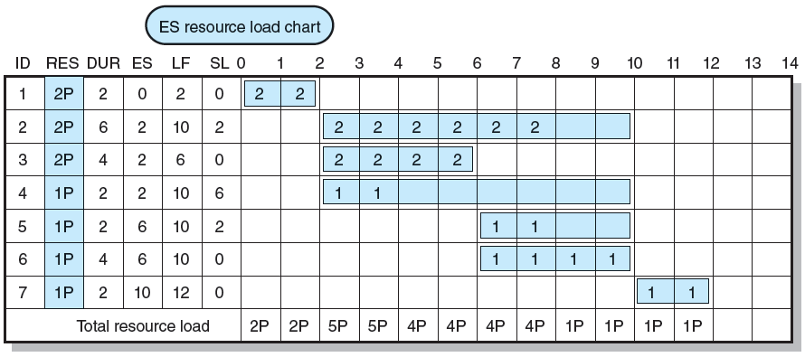
Resource-Constrained Schedule through Period 2–3
FIGURE 8.4 (cont’d)
Notes:
In Figure 8.4, the shaded areas in the early start resource loading chart represent the “scheduling interval” of the time-constrained schedule (ES through LF). For this schedule, the resource can be scheduled at any place within the interval and not delay the project. Scheduling the activity beyond the LF time will delay the project.

Slide 16
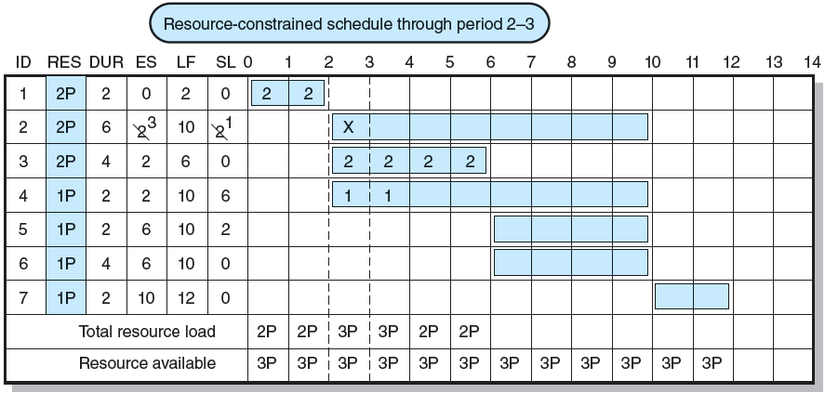
Resource-Constrained Schedule through Period 2–3
FIGURE 8.4 (cont’d)
Notes:
In Figure 8.4, the shaded areas in the resource loading chart represent the “scheduling interval” of the time-constrained schedule (ES through LF). For this schedule, the resource can be scheduled at any place within the interval and not delay the project. Scheduling the activity beyond the LF will delay the project.

Slide 17
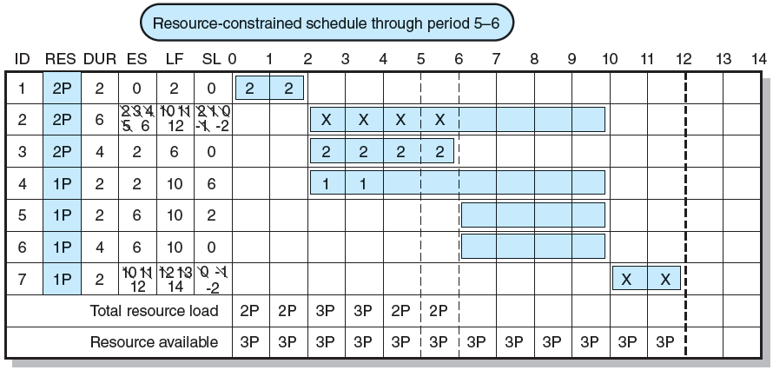
Resource-Constrained Schedule through Period 5–6
FIGURE 8.5
Notes:
Using the parallel scheduling method, the network in Figure 8.5 has been revised to reflect new start, finish, and slack times in a resource-constrained schedule for period 5-6.

Slide 18
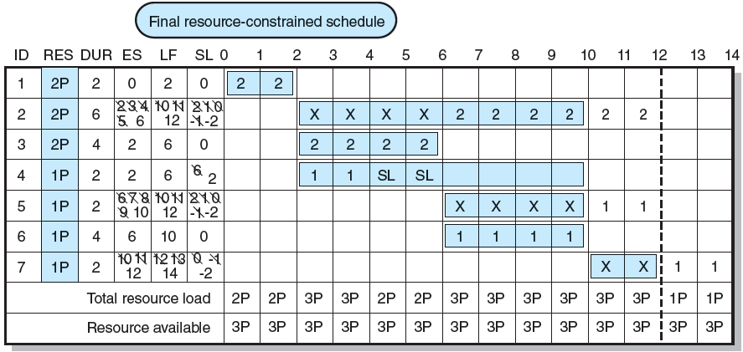
Resource-Constrained Schedule through Period 5–6
FIGURE 8.5 (cont’d)
Notes:
The network in Figure 8.5 reflects the new schedule ending date of 14 time units, rather than the previously time-constrained project duration of 12 time units in Figure 8.4. The network has also been revised to reflect new start, finish, and slack times for each activity. Note that activity 6 is still critical and has a slack of 0 time units because no resources are available (they are being used on activities 2 and 5). Slack has been reduced significantly for many activities resulting in an increase in the number of critical activities.

Slide 19
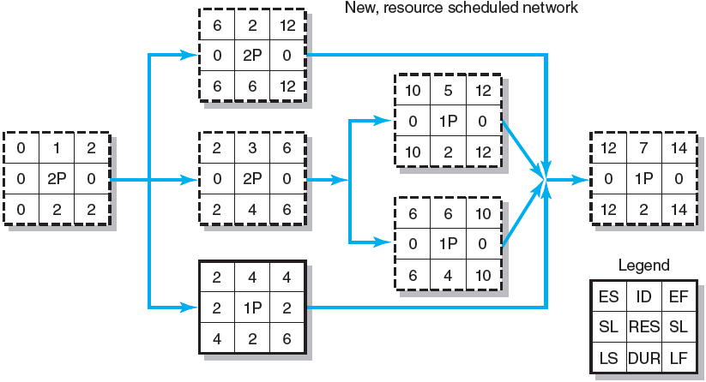
Resource-Constrained Schedule through Period 5–6
FIGURE 8.5 (cont’d)
Notes:
In Figure 8.5 (cont’d), the number of critical activities (boxes 1, 2, 3, 5, 6, 7) has increased from four to six as slack has been reduced throughout the project network.

Slide 20
Computer Demonstration of Resource-Constrained Scheduling
EMR Project
The development of a handheld electronic medical reference guide to be used by emergency medical technicians and paramedics.
Problem
There are only eight design engineers who can be assigned to the project due to a shortage of design engineers and commitments to other projects.
Notes:
EMR is the name given to the development of a handheld electronic medical reference guide to be used by emergency medical technicians and paramedics. A resource constraint on the project schedule is that there are only eight design engineers who can be assigned to the project due to a shortage of design engineers and commitments to other projects.
MS Project management software will be used to demonstrate software capable of assessing and resolving complicated resource-constrained schedules using heuristics.

Slide 21
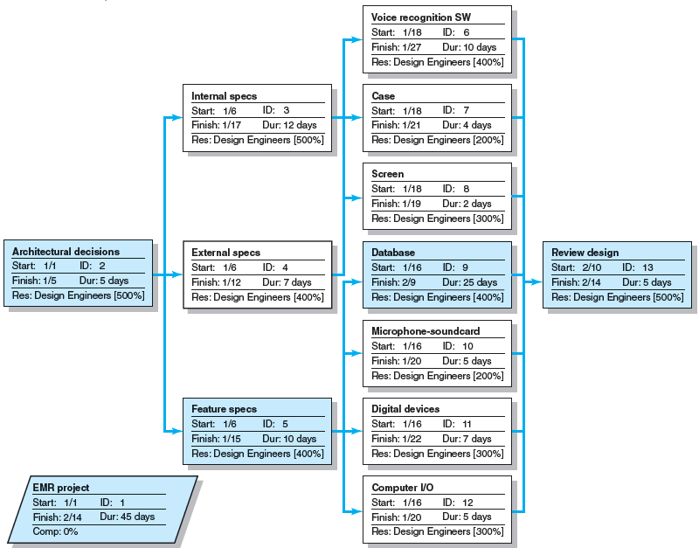
EMR Project: Network View Schedule before Resources Leveled
FIGURE 8.6
Notes:
Figure 8.6 depicts a time-limited network for the design phase of the EMR project based on the assumption that only design engineers are required for the tasks and that the design engineers are interchangeable. The number of engineers required to perform each task is noted in the network activity nodes, where 500 percent means five design engineers are needed for the activity. For example, activity 5, feature specs, requires four design engineers (400 percent).

Slide 22
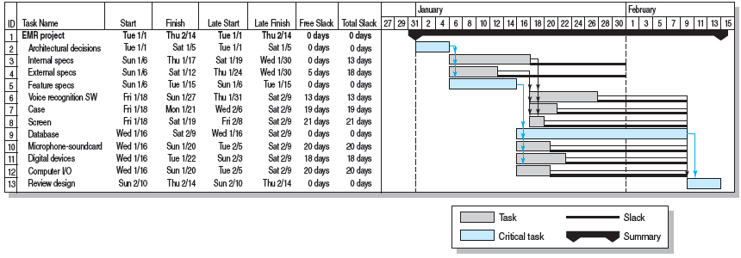
EMR Project before Resources Added
FIGURE 8.7
Notes:
The time-limited (constrained) bar chart for the EMR project is shown in Figure 8.7. This bar chart incorporates the same information used to develop the project network, but presents the project in the form of a bar chart along a time line.

Slide 23
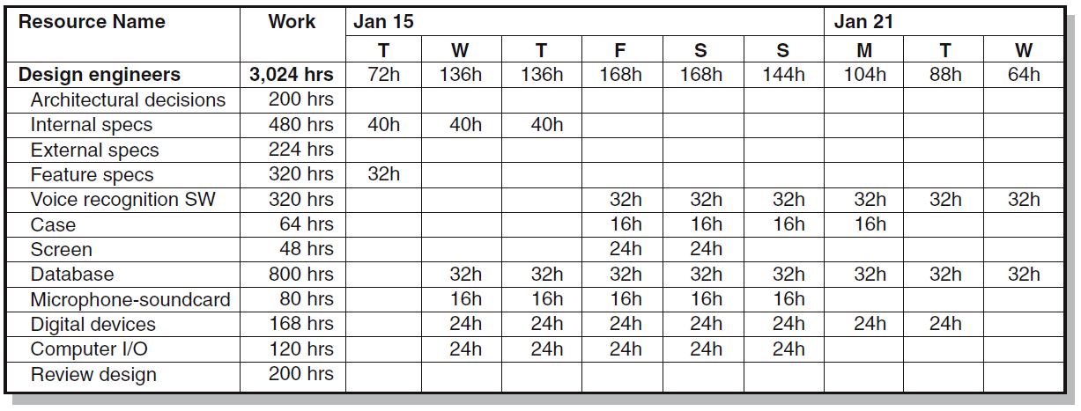
EMR Project—Time Constrained Resource Usage View, January 15–23
FIGURE 8.8A
Notes:
Figure 8.8A presents a resource usage chart for a time segment of the EMR project—January 15 to January 23. The time-limited project will require 21 design engineers on January 18 and 19 (168 hrs/8 hrs per engineer = 21 engineers). This segment represents the peak requirement for design engineers for the project. However, due to the shortage of design engineers and commitments to other projects, only eight engineers can be assigned to the project.

Slide 24
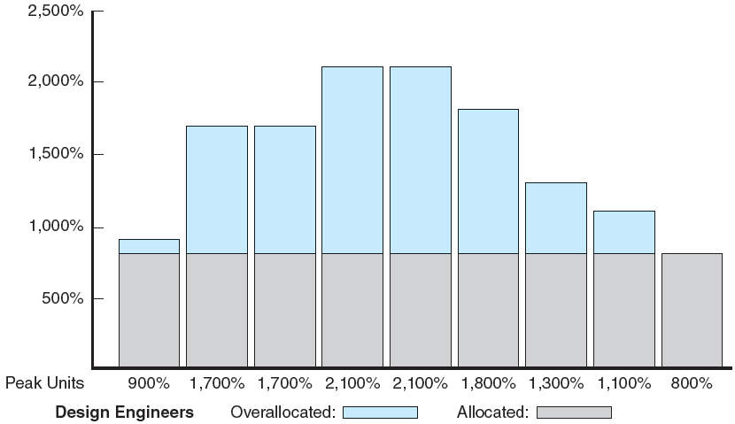
Resource Loading Chart for EMR Project, January 15–23
FIGURE 8.8B
Notes:
Figure 8.8B shows a bar chart illustrating the resource loading problems created by the overallocation of the constrained resource of design engineers during the January 15-23 time period.

Slide 25
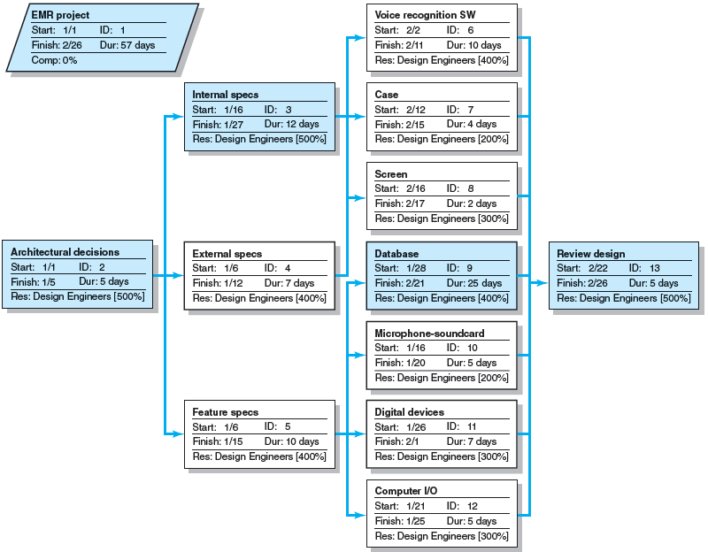
EMR Project Network View Schedule after Resources Leveled
FIGURE 8.9
Notes:
Figure 8.9 contains the revised, resource-limited network chart that represents a new schedule for the EMR project. The revised resource-limited project network indicates that project duration has been extended to 2/26, or 57 workdays (versus 45 days for time-limited network). The critical path has become activities 2, 3, 9, 13.

Slide 26
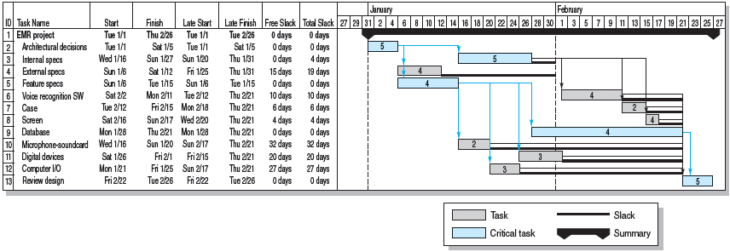
EMR Project Resources Leveled
FIGURE 8.10
Notes:
Figure 8.10 presents the EMR project as a horizontally horizontally-aligned bar chart that maps the results of leveling the project schedule to reflect the availability of only eight design engineers. The application of the heuristics can be seen in the scheduling of the internal, external, feature, and specification activities based on reduced slack, shortened duration, and criticality considerations.

Slide 27
The Impacts of Resource-Constrained Scheduling
Reduces delay but reduces flexibility.
Increases criticality of events.
Increases scheduling complexity.
May make the traditional critical path no longer meaningful.
Can break sequence of events.
May cause parallel activities to become sequential and critical activities with slack to become noncritical.
Notes:
Like leveling schedules, the limited resource schedule usually reduces slack, reduces flexibility by using slack to ensure delay is minimized, and increases the number of critical and near-critical activities. Scheduling complexity is increased because resource constraints are added to technical constraints; start times may now have two constraints while parallel activities can become sequential and time-based activities with slack can change from critical to noncritical..

Slide 28
Splitting
Splitting
A scheduling technique for creating a better project schedule and/or increase resource utilization.
Involves interrupting work on an activity to employ the resource on another activity, then returning the resource to finish the interrupted work.
Is feasible when startup and shutdown costs are low.
Is considered the major reason why projects fail to meet schedule.
Notes:
Splitting is a scheduling technique used to get a better project schedule and/or to increase resource utilization when:
A resource at work can be interrupted on an activity to use that resource on another activity, then return the resource to the original activity to finish the interrupted work.
When startup and shutdown interruption costs for splitting resources are low.
Interruption is not likely to cause the project to fail to meet schedule.

Slide 29
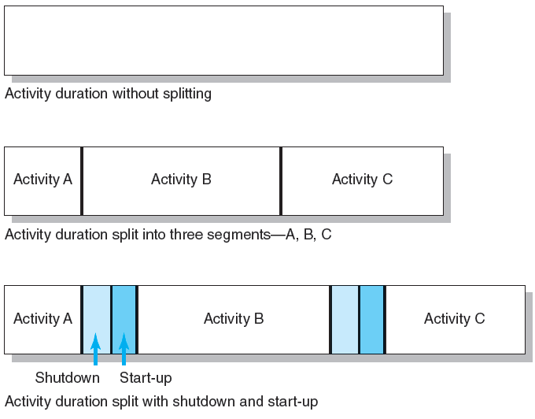
Splitting Activities
FIGURE 8.11
Notes:
Figure 8.11 depicts, in bar chart form, the effects/costs of splitting an original activity into three separate activities: A, B, and C. The shutdown and start-up times associated with spitting work on both activities A and B have lengthen the overall duration time for the original activity.

Slide 30
Benefits of Scheduling Resources
Leaves time for consideration of reasonable alternatives:
Cost-time tradeoffs
Changes in priorities
Provides information for time-phased work package budgets to assess:
Impact of unforeseen events
Amount of flexibility in available resources
Notes:
For projects with where resources are limited and activity time estimates are accurate, the resource-constrained schedule will materialize as the project is implemented—not the time-constrained schedule! Therefore, failure to schedule limited resources can lead to serious problems for a project manager. The benefit of creating this schedule before the project begins is that it leaves time for considering reasonable alternatives.
Resource schedules help in preparing time-phased work package budgets with dates and are a quick means for a project manager to gauge the impact of unforeseen events such as turnover, equipment breakdowns, or transfer of project personnel. Resource schedules also allow project managers to assess the flexibility they have in the sharing of certain resources.

Slide 31
Multiproject Resource Schedules
Multiproject Scheduling Problems
Overall project slippage
Delay on one project create delays for other projects.
Inefficient resource application
The peaks and valleys of resource demands create scheduling problems and delays for projects.
Resource bottlenecks
Shortages of critical resources required for multiple projects cause delays and schedule extensions.
Notes:
Multiproject scheduling problems are sourced in several areas:
Overall project slippage that occurs when delay on one project create delays for other projects.
Inefficient resource application due to inefficiencies induced by peaks and valleys of resource demands.
Resource bottlenecks due to shortages of critical resources required for multiple projects cause delays and schedule extensions.

Slide 32
Multiproject Resource Schedules (cont’d)
Managing Multiproject Scheduling:
Create project offices or departments to oversee the scheduling of resources across projects.
Use a project priority queuing system: first come, first served for resources.
Centralize project management: treat all projects as a part of a “megaproject.”
Outsource projects to reduce the number of projects handled internally.
Notes:
Managing multiproject scheduling requires:
Creation of project offices or departments to oversee the scheduling of resources across projects.
Use of a project priority queuing system: first come, first served for resources.
Centralization of project management efforts that treat all projects as a part of a “megaproject.”
Outsourcing of projects to reduce the number of projects handled internally.

Slide 33
Using the Resource Schedule to Develop a Project Cost Baseline
Why a Time-Phased Budget Baseline Is Needed
To determine if the project is on, ahead, or behind schedule and over or under its budgeted costs?
To know how much work has been accomplished for the allocated money spent—the project cost baseline (planned value, PV)
Creating a Time-Phased Budget
Assign each work package to one responsible person or department and deliverable.
Compare planned schedule and costs using an integrative system called earned value.
Notes:
A time-phased budget baseline is needed to determine if the project is on, ahead, or behind schedule and over or under its budgeted costs and to know how much work has been accomplished for the allocated money spent—the project cost baseline (planned value, PV)
Project managers create a time-phased budget by assigning each work package to one responsible person or department and deliverable. They can then compare the planned schedule and its costs using an integrative system called earned value.

Slide 34
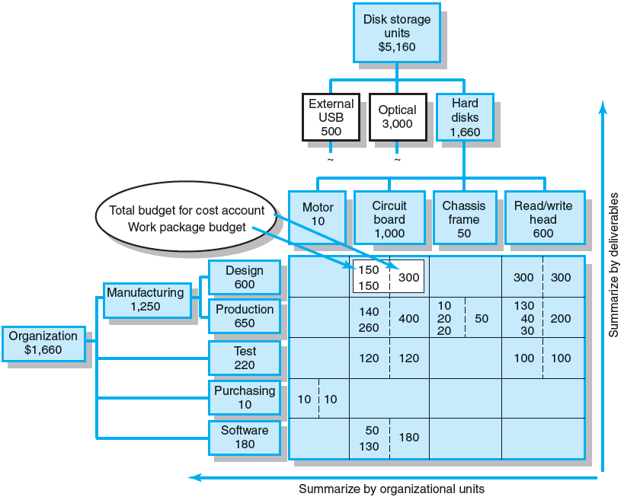
Direct Labor Budget Rollup ($000)
FIGURE 8.12
Notes:
Figure 8.12 presents a direct labor budget roll-up example of the PC Prototype Project arranged in a matrix format by WBS deliverable and the OBS organization unit responsible. At each intersection point of the WBS/OBS matrix, work package budgets and the total cost (a cost or control account) is shown. For example, at the intersection of the Read/write head deliverable and the Production department, there are three work packages with a total budget of $200,000. The sum of all cost accounts in a column represents the total costs for the deliverable. Conversely, the sum of the cost accounts in a row represents the costs or budget for the organizational unit responsible to accomplish the work. Managers can continue to “roll up” costs on the WBS/OBS to total project costs. This WBS provides the information needed to time phase work packages and assign them to their respective scheduled activities over the life of the project.

Slide 35
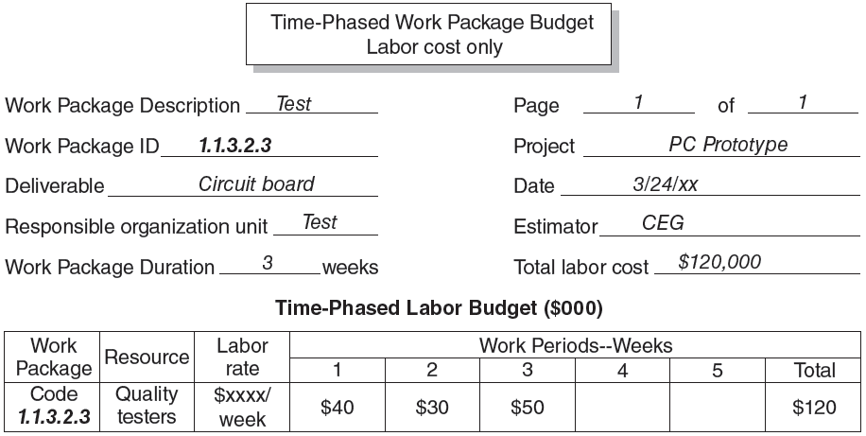
Time-Phased Work Package Budget (Labor Cost Only)
FIGURE 8.13
Notes:
Figure 8.13 illustrates the process of time-phasing work packages in a filled-out form that details the time-phased budget for labor costs for a project deliverable named circuit board. Time-phasing of a work package is critical for the final step of creating a budget baseline.
In this example the work package has a duration of three weeks. Assuming labor, materials, and equipment are tracked separately, the work package costs for labor are distributed over the three weeks as they are expected to occur—$40,000, $30,000, and $50,000 for each week, respectively. When the three-week work package is placed in the network schedule, the costs are distributed to the time-phased budget for the same three scheduled weeks.

Slide 36
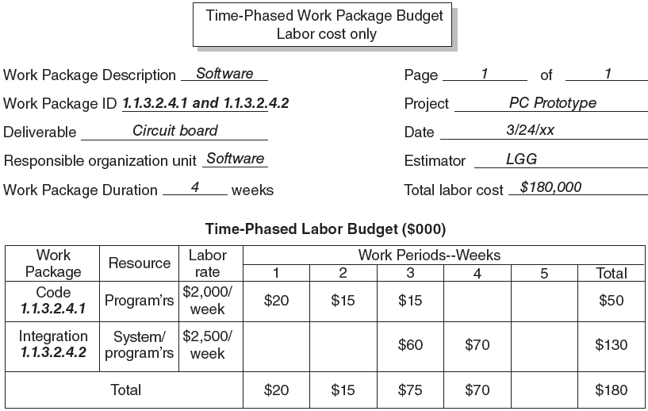
Two Time-Phased Work Packages (Labor Cost Only)
FIGURE 8.14
Notes:
In Figure 8.14, a filled-out form details the time-phased budget for labor costs for a project deliverable named circuit board that includes two work packages (WPs). The first, WP-1.1.3.2.4.1 (Code), is distributed over the first three weeks. The second, WP-1.1.3.2.4.2 (Integration), is sequenced over weeks 3 and 4. The activity duration is four weeks. When the activity is placed in the schedule, the costs are distributed starting with the schedule start—$20,000, $15,000, $75,000, and $70,000, respectively.

Slide 37
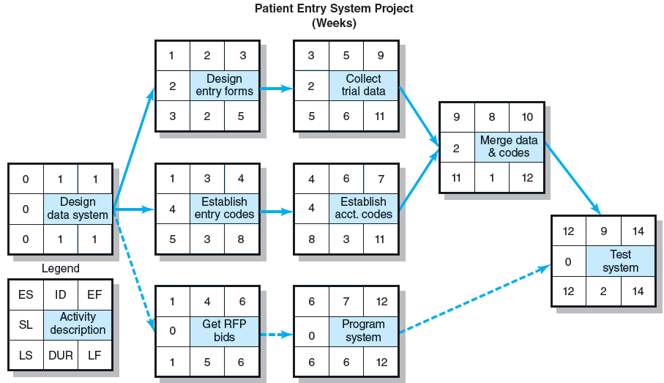
Patient Entry Project Network
FIGURE 8.15
Notes:
Figure 8.15 shows the boxed-format Patient Entry Project network schedule which is used to place the budgets for time-phased work packages in the project baseline.

Slide 38
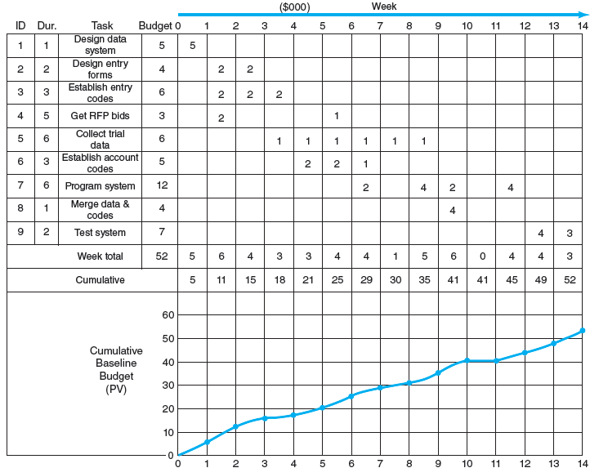
Patient Entry Time-Phased Work Packages Assigned
FIGURE 8.16
Notes:
Figure 8.16 presents a row and column chart of the time-phased budget for the Patient Entry Project and the cumulative graph of the project’s budget baseline. This figure shows how the time-phased work package costs were placed into the network and how the cumulative project budget graph for a project is developed. Costs do not have to be distributed linearly, but the costs should be placed as you expect them to occur.

Slide 39
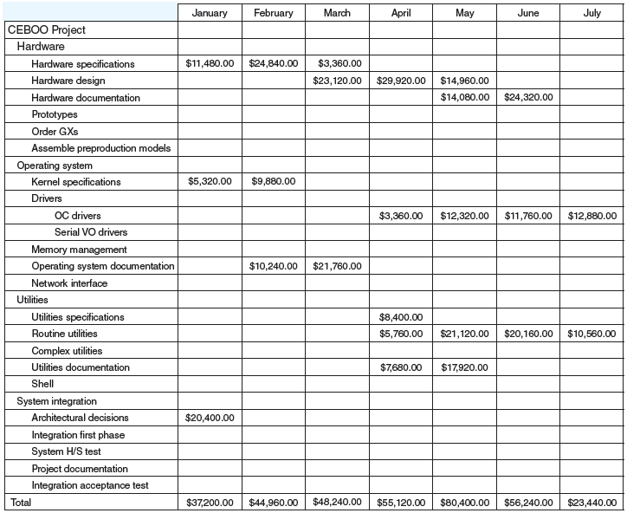
CEBOO Project Monthly Cash Flow Statement
FIGURE 8.17
Notes:
Once a project budget baseline established, project managers are able to generate cash flow statements for a project like the CEBOO example presented in column and row format in Figure 8.17. Such statements prepare the firm to cover costs over the lifespan of the project.

Slide 40
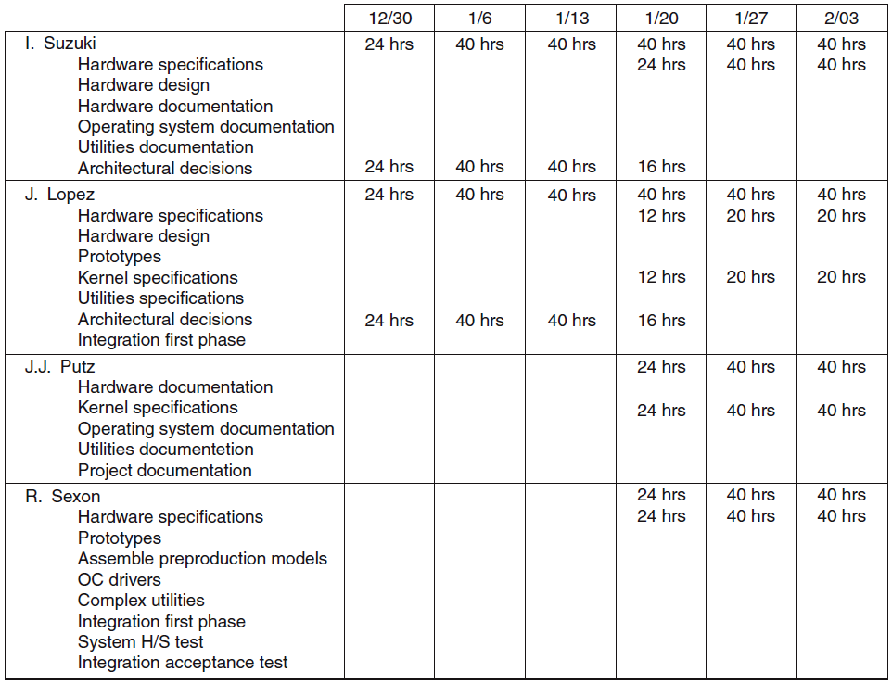
CEBOO Project Weekly Resource Usage Schedule
FIGURE 8.18
Notes:
With resource assignments finalized, managers are able to generate resource usage schedules for their project as seen in the column and row format of the CEBOO project example in Figure 8.18. These schedules map out the full deployment of personnel and equipment and can be used to generate individual work schedules.

Slide 41
Key Terms
Heuristic
Leveling
Planned value (PV)
Resource-constrained projects
Resource smoothing
Splitting
Time-constrained projects
Time-phased budget baseline
Notes:
Heuristic is a rule of thumb used to make decisions.
Leveling is the process of examining a project for an unbalanced use of resources, and for resolving resource over-allocations
Planned value (PV) is the planned time-phased baseline of the value of the work scheduled. Previously this was called budgeted cost of work scheduled (BCWS).
Resource-constrained projects are projects in which it is assumed that resources are limited (fixed) and therefore time is variable.
Resource smoothing involves trying to reduce the peak of the resource usage to improve the overall utilization of the resource.
Splitting is a scheduling technique in which work is interrupted on one activity and the resource is assigned to another activity for a period of time, then reassigned to work on the original activity
Time-constrained projects assume time is fixed and, if resources are needed, they will be added.
Time-phased budget baseline breaks panned costs down by distinct time periods for a work package to allow better cost control by measuring the actual rate of expenditure versus the planned expenditure rate over small pieces of the project.

